Slide 1
py-piano
Presented by:-
AVANTIKA
Mr. Abhay Jain
(Supervisor name)

Slide 2
TABLE OF CONTENT
Objective
Introduction
Need and Scope
Methodology
Work flow of project
Technology Bucket
Outcome of project

Slide 3
Introduction
Piano is a musical instrument that user plays by pressing black and white keys on a keyboard.
Piano comes from the original Italian name for the instrument: piano e forte, “soft and loud”
There are twelve possible keys any particular song can be played in. These are A, A#/Bb, B, C, C#/Db, D, D#/Eb, E, F, F#/Gb, G, and G#/Ab.

Slide 4
Objective
The objective of this project is to provide a melodious and soothing experience to the user and help to relieve their stress instantly because it is also scientifically proved that music can calm one’s mood.
Studies show that time spent at the piano keyboard improves mental health.

Slide 5
Need and Scope
1. Playing piano offers different physical and physiological advantages to players .
2. Piano helps people to relief their stress .
3. Piano helps to sharpen the concentration skills of people .
4. Playing the piano is good for the physical health .
5. It improves test scores and the school performance of a student .
6. Swimmers generally listen soft music to enhance their performance . Thus, piano can play an important role in such case.
7. Studies show that students who plays piano had increased levels of HgH (Human Growth Hormones) in their system .
8. Playing the piano can improve your overall aural awareness no matter where you fall in the range .
9. Playing piano increases the creativity of human being.

Slide 6
Methodology
Here, I have design a piano by using python programming language.
The methodology used in this project is to provide a melodious and soothing experience to the user so that they can overcome their stress. Piano gives soft and loud sound which actually calms one’s mind and can improve their mood.
Whenever the user presses any key of the piano, the sound of that particular key plays.

Slide 7
WORKFLOW OF PROJECT
START
Interface of piano opens
Press any key of piano
Sound of a key user pressed plays
END

Slide 8


Technology Bucket
I have implemented this project by using world’s most popular programming language:
PYTHON

Slide 9
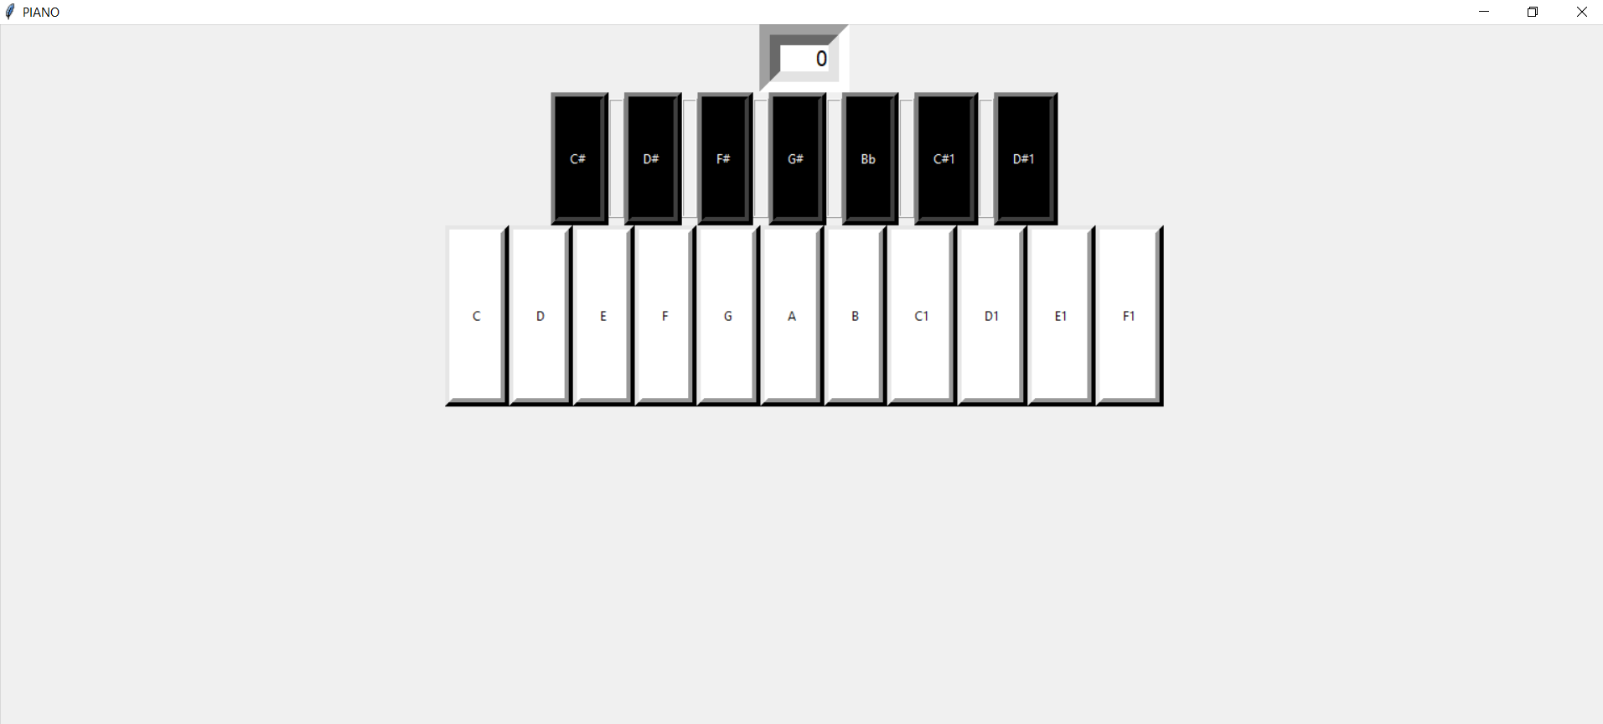
Outcome

Slide 10
References
Website:- https://www.w3schools.com/
Youtube:- https://youtu.be/gfDE2a7MKjA
Sound :-https://freesound.org/people/Tesabob2001/packs/12995/
Wikipedia
And even some other references too.

Slide 11
THANK YOU

